Slide 1


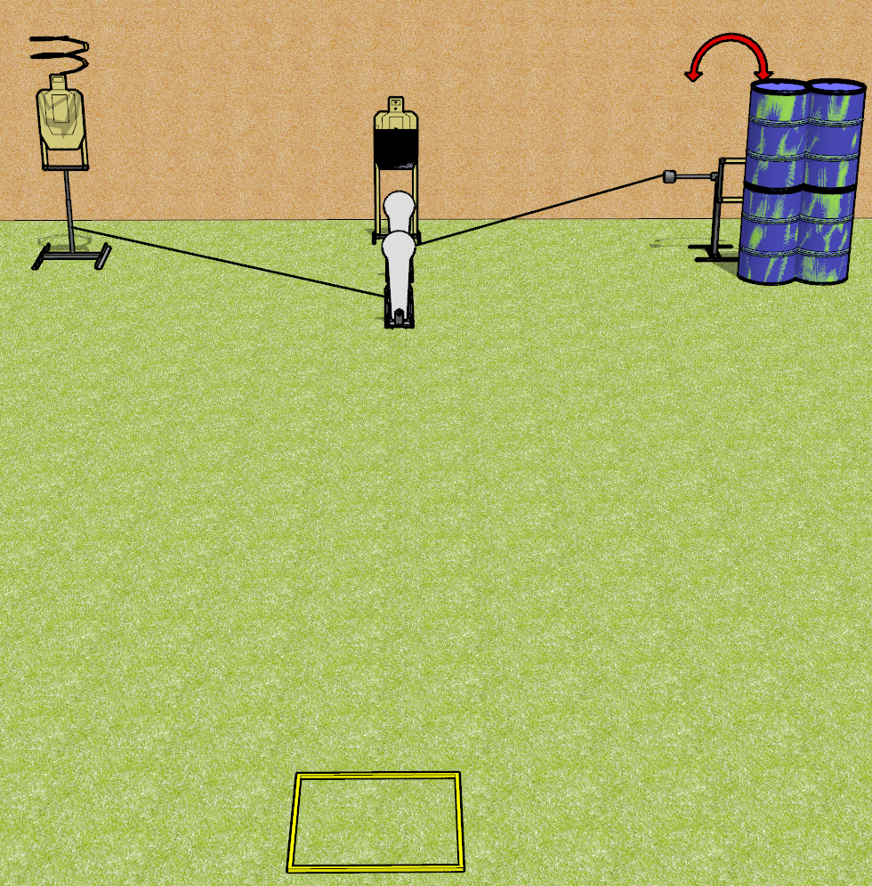
 | Dothan Gun Club – USPSA Match Lag Time Course Designer : Drew Coleman
Round Count 8 rounds 3 USPSA targets 2 colt poppers
Equipment List Drop turner, swinger, 2 activators Shooting box 1 50% hard cover

Slide 2
Lag Time
Written Stage Briefing
Lag Time is an 8 round, 40 point, Comstock course of fire. There are 3 USPSA targets and 2 colt poppers. The best 2 hits on paper will score, and steel must fall to score. The start signal is audible.
The front colt popper activates the drop turner. The drop turner is a disappearing target. The rear colt popper activates the swinger, which remains visible at rest.
Handgun start position is toes against the back of the shooting area, facing up range, wrists above respective shoulders. Handgun is loaded and holstered.
PCC start position is heels against the back of the shooting area, stock on belt. Loaded carbine is held with both hands, safety on.
On start signal, engage targets as they become available from within the shooting area.

Slide 3
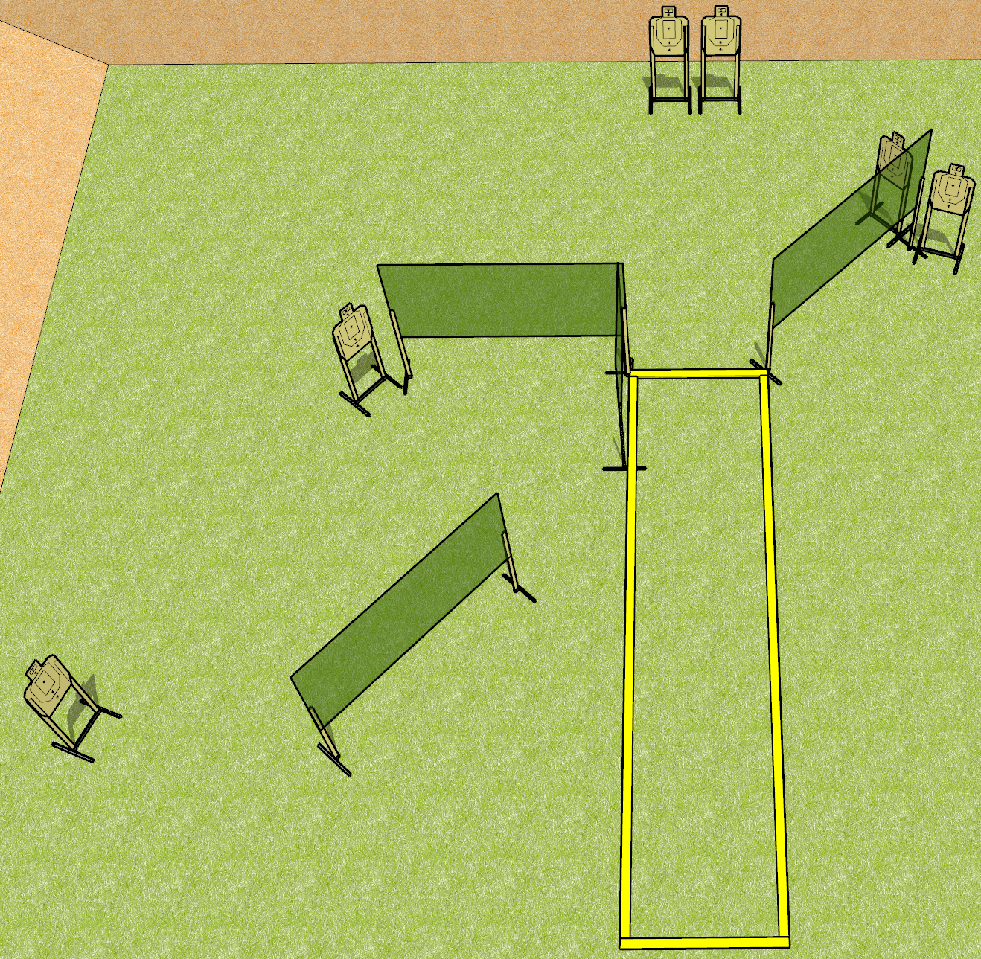
 | Dothan Gun Club – USPSA Match Moving the Standard Course Designer : Drew Coleman
Round Count 24 rounds 6 USPSA targets
Equipment List 7 wall feet 2 medium fault lines 4 10’ fault lines

Slide 4
Moving the Standard
Written Stage Briefing
Moving the Standard is a 24 round, 120 point, Virginia Count standard exercise. There are 6 USPSA targets. The best 4 hits on paper will score. The start signal is audible.
Handgun start position is heels touching rear fault line for string 1, and toes touching front fault line for string 2, wrists below belt. Handgun is loaded and holstered.
PCC start position heels touching rear fault line for string 1, and toes touching front fault line for string 2. Loaded carbine is held with both hands, stock on belt, safety on.
String 1 stage procedure: on start signal, from within the shooting area, engage any 3 targets with only 2 rounds each, perform a mandatory reload, and engage remaining 3 targets with only 2 rounds each.
String 2 stage procedure: on start signal, from within the shooting area, engage any 3 targets with only 2 rounds each, perform a mandatory reload, and engage remaining 3 targets with only 2 rounds each Strong Hand Only.

Slide 5
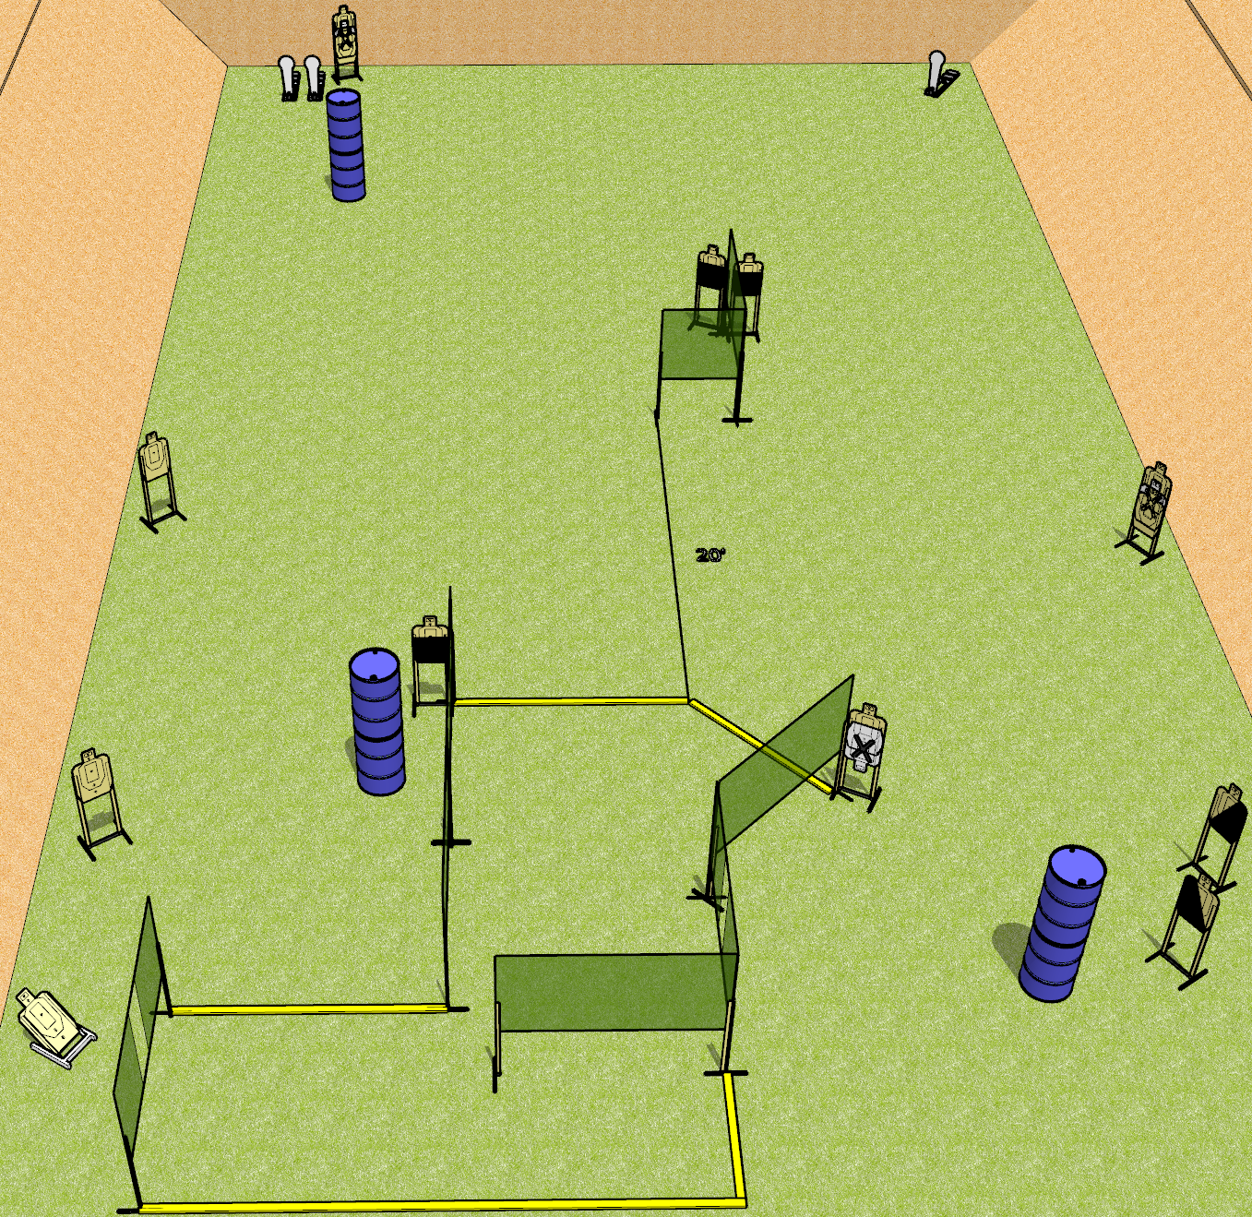
 | Dothan Gun Club – USPSA Match Ride the Lightning Course Designer : Drew Coleman
Round Count 29 rounds 13 USPSA 3 colt poppers
Equipment List 13 wall feet 2 medium fault lines 3 50%, 1 left and 1 right diagonal

Slide 6
Ride the Lightning
Written Stage Briefing
Ride the Lightning is a 29 round, 145 point, Comstock course of fire. There are 13 USPSA targets and 3 colt poppers. The best 2 hits on paper will score, and steel must fall to score. The start signal is audible.
Handgun start position is anywhere completely outside the shooting area, wrists below belt. Handgun is loaded and holstered.
PCC start position is anywhere completely outside the shooting area, stock on belt. Loaded carbine is held with both hands, safety on.
On start signal, engage targets as they become available from within the shooting area.

Slide 7
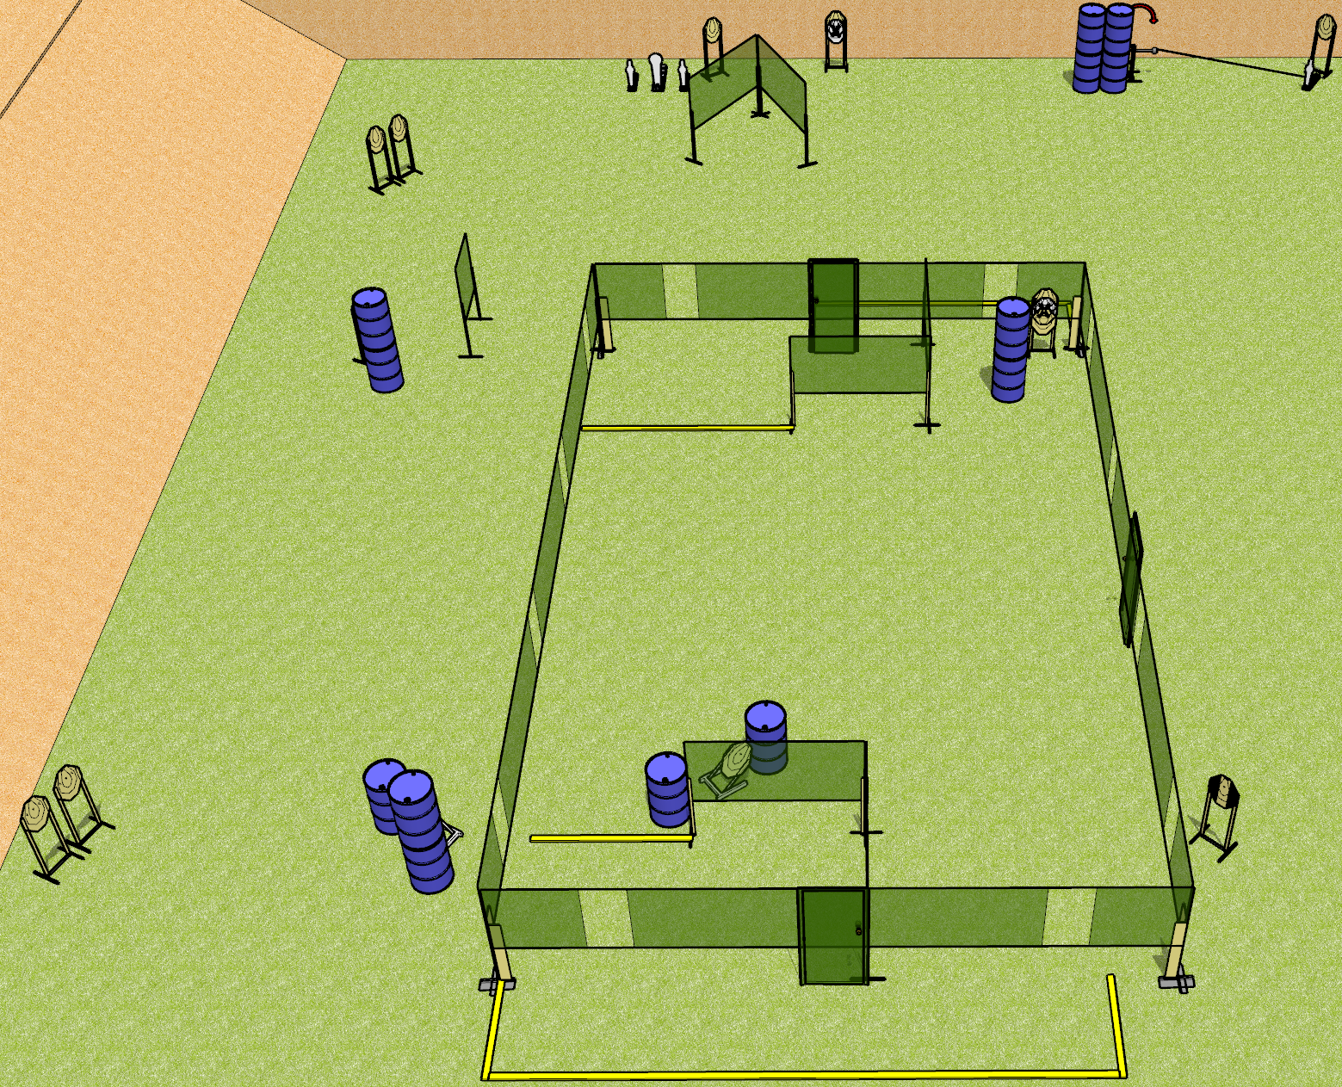
 | Dothan Gun Club – USPSA Match One End to the Other Course Designer : Drew Coleman
Round Count 32 rounds 14 IPSC 2 colt poppers, 2 mini poppers
Equipment List 6 wall feet 4 medium fault lines 1 tux

Slide 8
One End to the Other
Written Stage Briefing
One End to the Other is a 32 round, 160 point, Comstock course of fire. There are 14 IPSC targets, 2 colt poppers, and 2 mini poppers. The best 2 hits on paper will score, and steel must fall to score. The start signal is audible.
The swinger is activated by the right mini popper and remains visible at rest.
Handgun start position is inside the shooting area, wrists below belt. Pistol is loaded and holstered.
PCC start position is inside the shooting area, stock on belt. Loaded carbine is held with both hands, safety on.
On start signal, engage targets as they become available from within the shooting area.

